Slide 1
I See Metrics: Anomaly Detection on OpenShift
AI Ops in the AI Center of Excellence
DevConf.CZ 2020
Hema Veeradhi (Software Engineer)
Anand Sanmukhani (Software Engineer)
Michael Clifford (Senior Data Scientist)

Slide 2
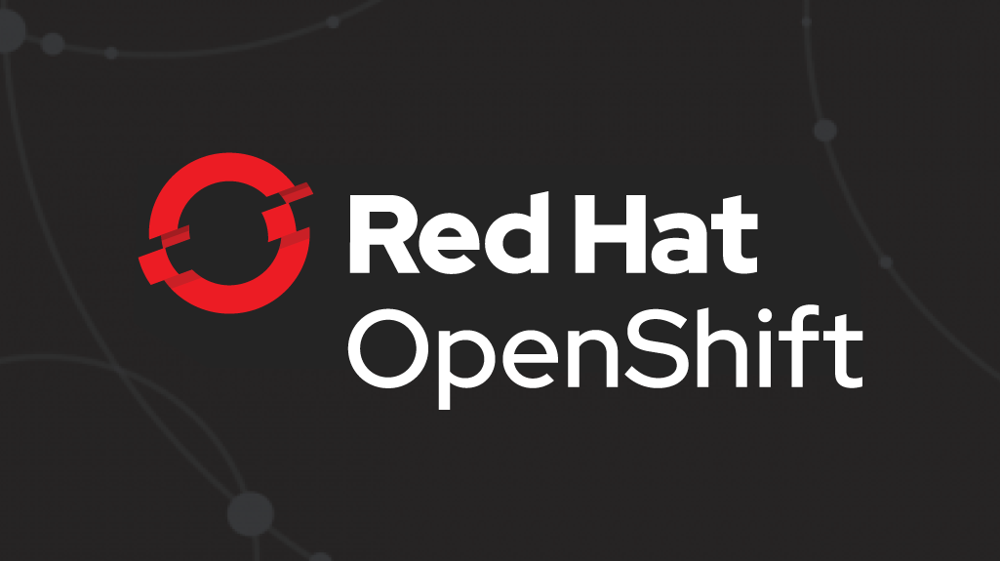


AI-backed anomaly detection for prometheus metrics.
Monitoring
Applications
Prometheus
Notes:
As IT operations become more agile and complex, at the same time the need to enhance operational efficiency and intelligence grows. Monitoring applications and kubernetes clusters with Prometheus has become quite common. Yet, identifying relevant metrics and thresholds for your setup is getting harder.

Slide 3
Goals of Workshop
Understanding Prometheus
Monitoring applications and its challenges
Leveraging AI for better monitoring
Data Science toolkit
Anatomy of an anomaly
Integrating anomaly detection pipeline into monitoring setup

Slide 4

Simplistic world view

Slide 5
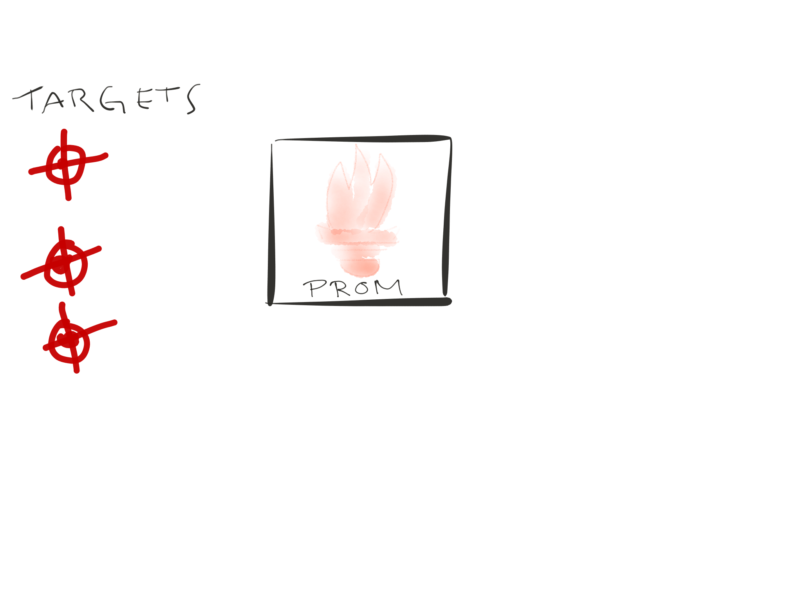
Notes:
And we got target, these are the things that prometheus want to monitor

Slide 6
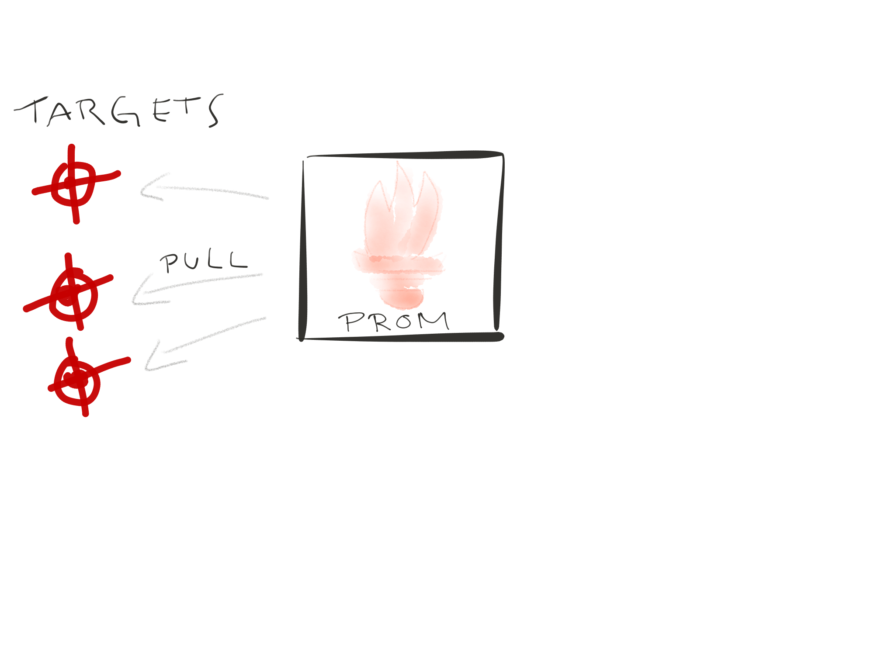
Notes:
Those targets expose metrics, just via http endpoints
The metrics are the current state of the target
This is important.
A target cant tell prometheus, this is how I looked like 10 minutes ago
Prometheus is the one who adds a timestamp to the metrics and the time is always now

Slide 7
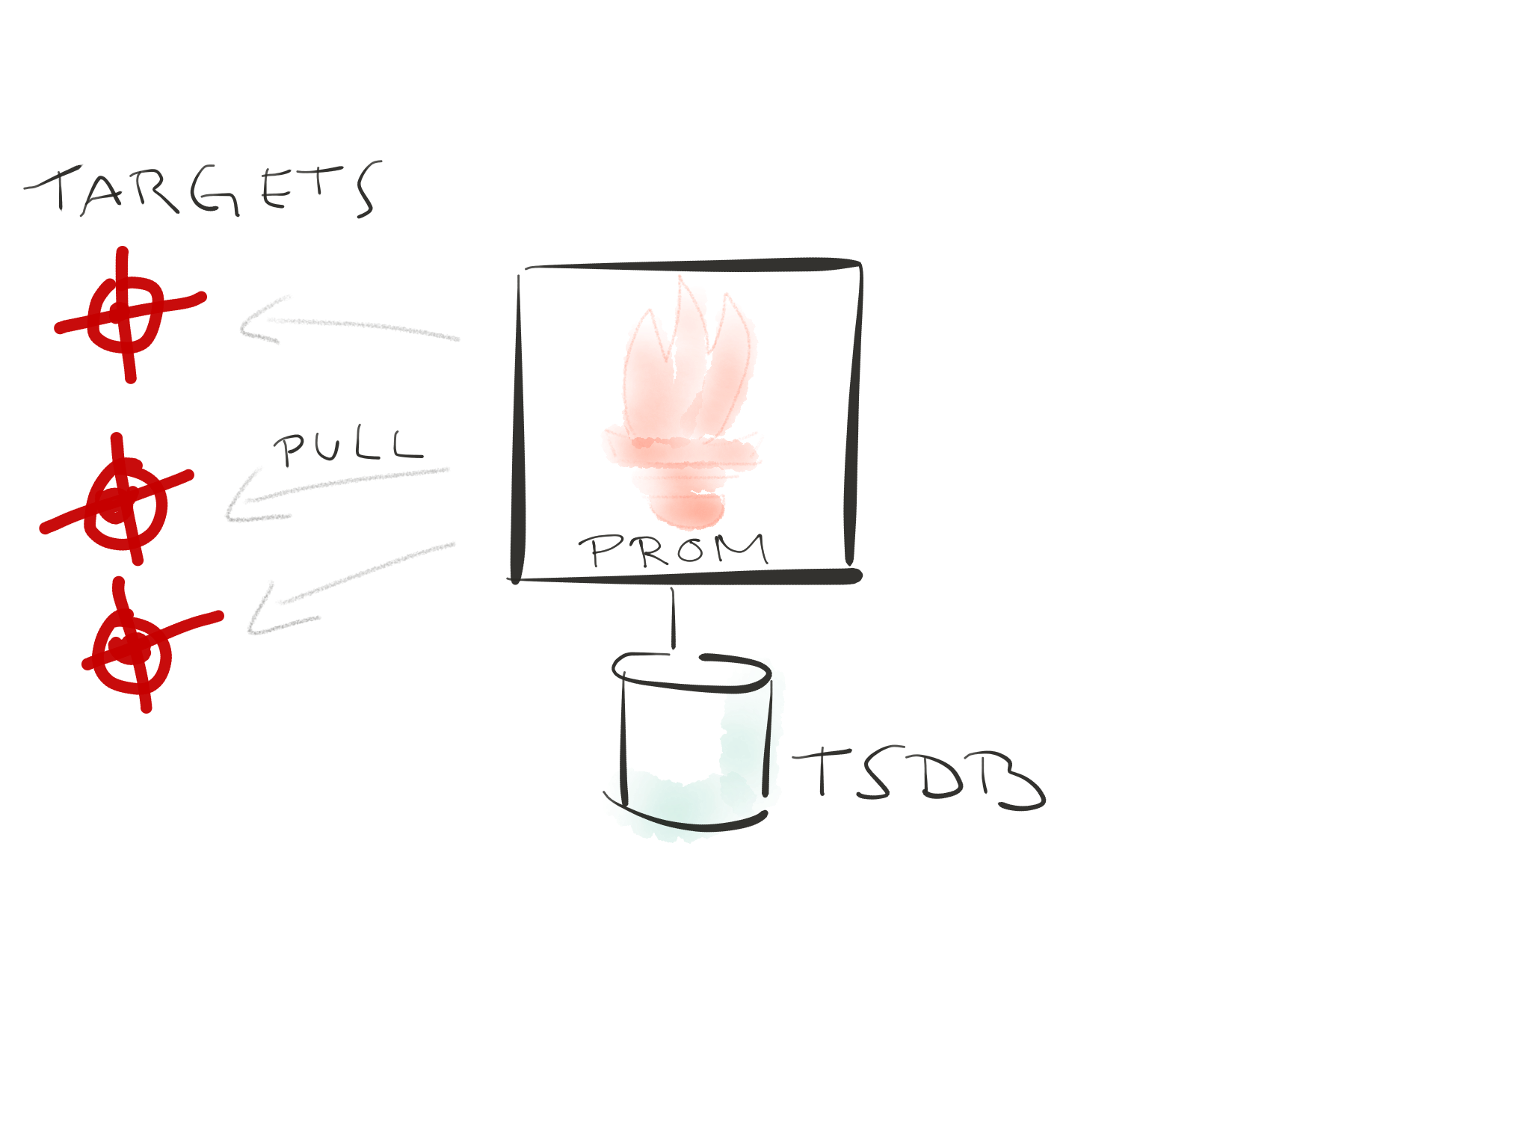
Notes:
Then prometheus stores the metrics in it’s times series db which is really performant and optimized for this kind of data
And you can query the TSDB with a powerful query language called promql

Slide 8
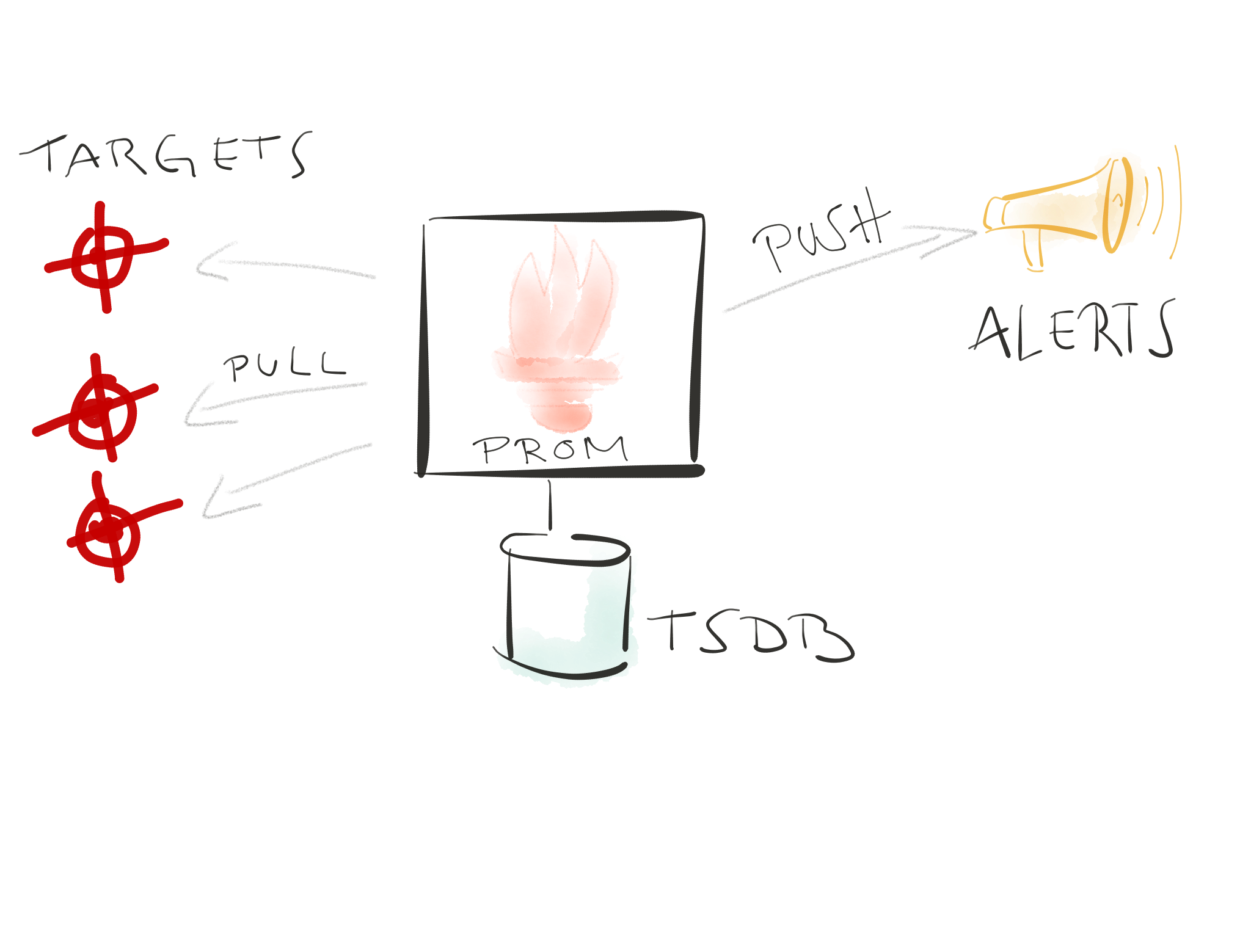
Notes:
Now, metrics are nothing if dont get notified, right?
So prometheus can store rules that will fire and trigger alerts.
It’ll push the alerts to an alertmanager which will take care that you are being notified

Slide 9
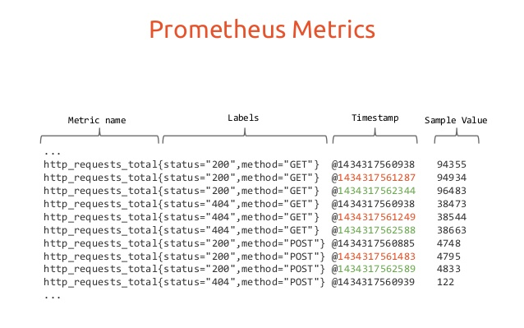
AI Ops
Gauge - Arbitrary up and down value
Counter - Monotonically Increasing
Histogram - Cumulative samples of values
Summary - Snapshot of values in a time window
Notes:
With the increased amount of metrics flowing in it is getting harder to see the signals within the noise. Our application leverages machine learning algorithms such as Fourier and Prophet models to perform time series forecasting and predict anomalous behavior in the metrics. (Eg: CPU usage)

Slide 10
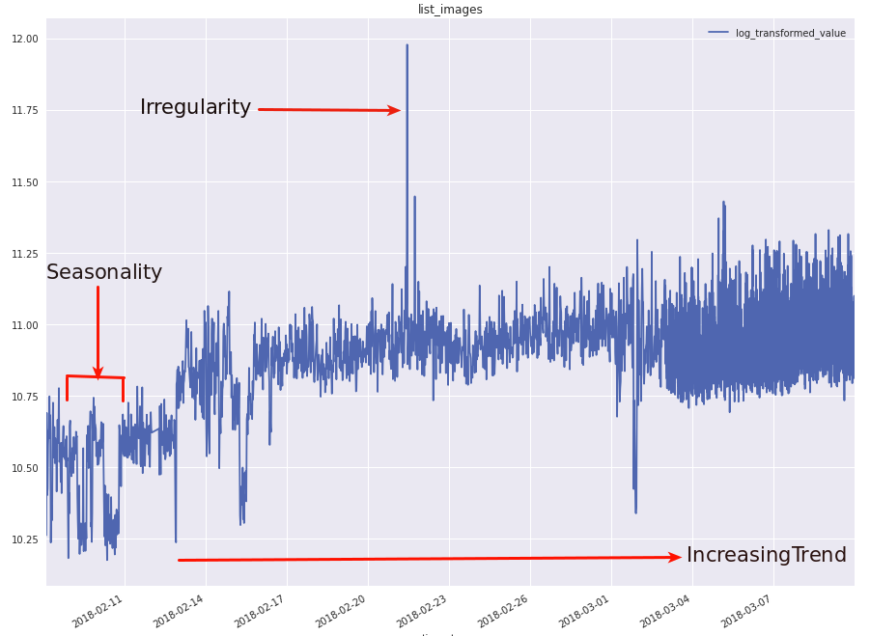
Components of Time Series
Trend
Increase or decrease in the series over a period of time.
Seasonality
Regular pattern of up and down fluctuations. It is a short-term variation occurring due to seasonal factors.

Slide 11
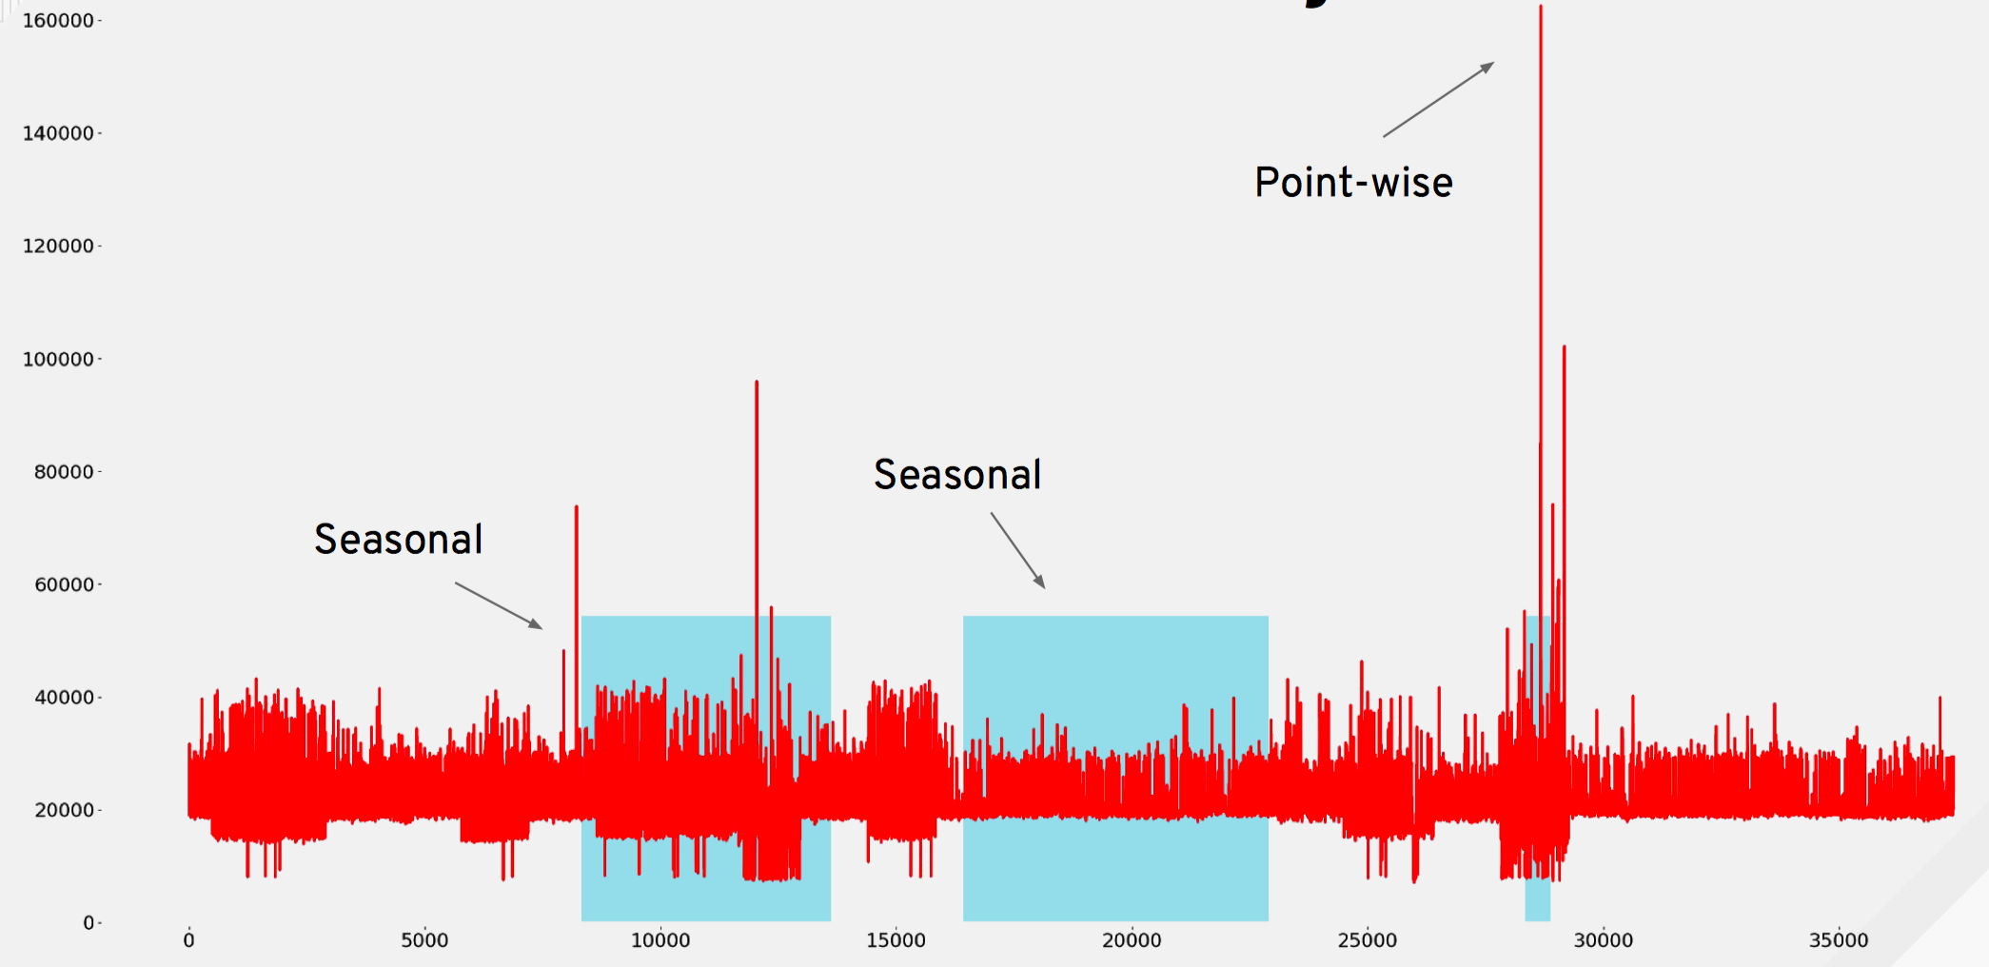
Anomaly Types
Notes:
An anomaly would be any behaviour that doesnt adhere to the seasonality, the trend or the overall predict values of the time series.
Here we’re seeing 2 seasonal anomalies, the values dont cycle as expected
and a point wise anomaly, were we have a hard spike in the values

Slide 12




Toolkit
Prometheus

Slide 13
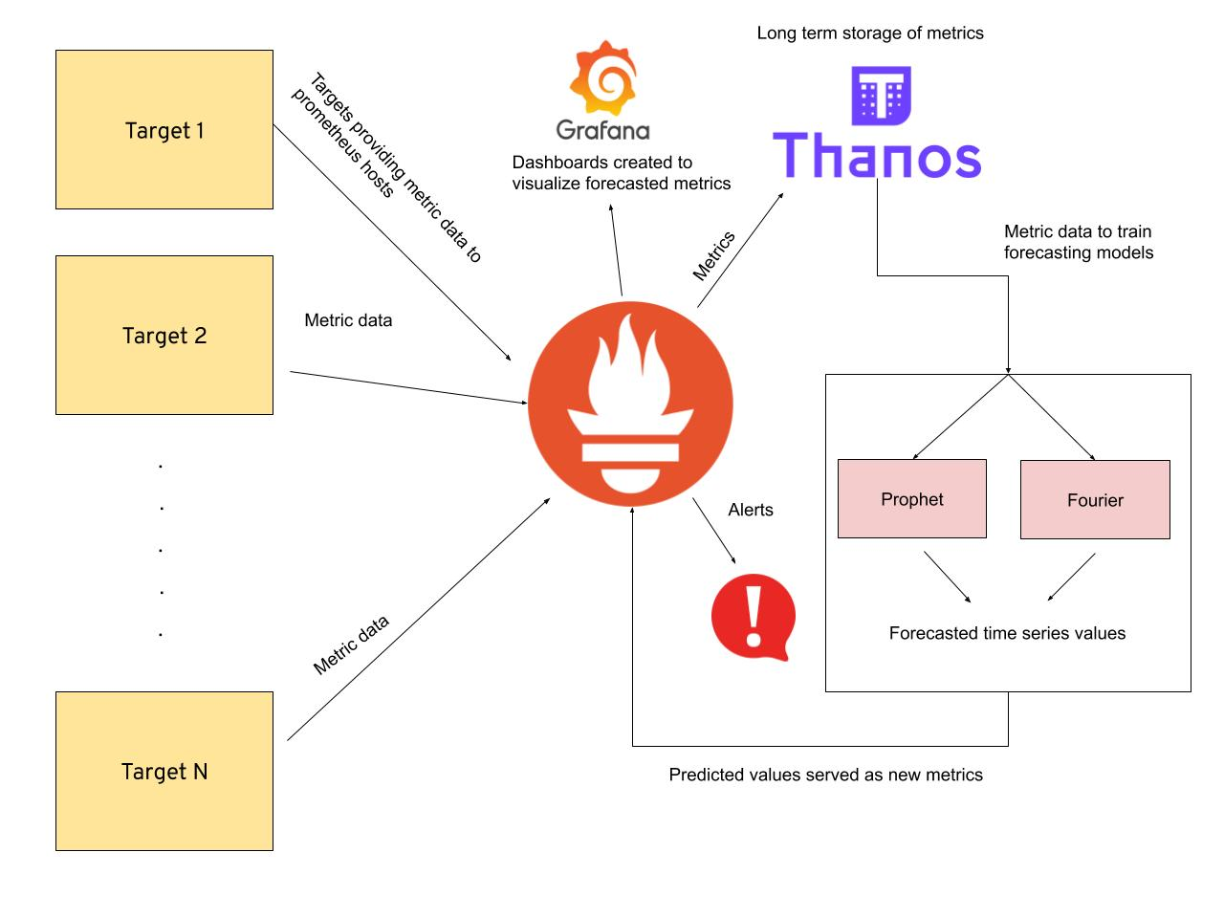
Implementation setup so far
AI Ops
Notes:
Data - Prometheus metrics scraped from specified hosts/targets
Models being trained -
Fourier - It is used to map signals from the time domain to the frequency domain. It represents periodic time series data as a sum of sinusoidal components (sine and cosine)
Prophet[https://facebook.github.io/prophet/] - Procedure developed by Facebook for forecasting time series data based on an additive model where non-linear trends are fit with yearly, weekly, and daily seasonality, plus holiday effects. It works best with time series that have strong seasonal effects and several seasons of historical data. The following are the forecasted values:
yhat - Predicted time series value
yhat_lower - Lower bound of uncertainity interval
yhat_upper - Upper bound of uncertainity interval
Visualization - Grafana dashboards are created to visualize the predicted metrics
Alerts - Prometheus alerts are configured based on predicted metric values. Alerts triggered via gchat/email.

Slide 14
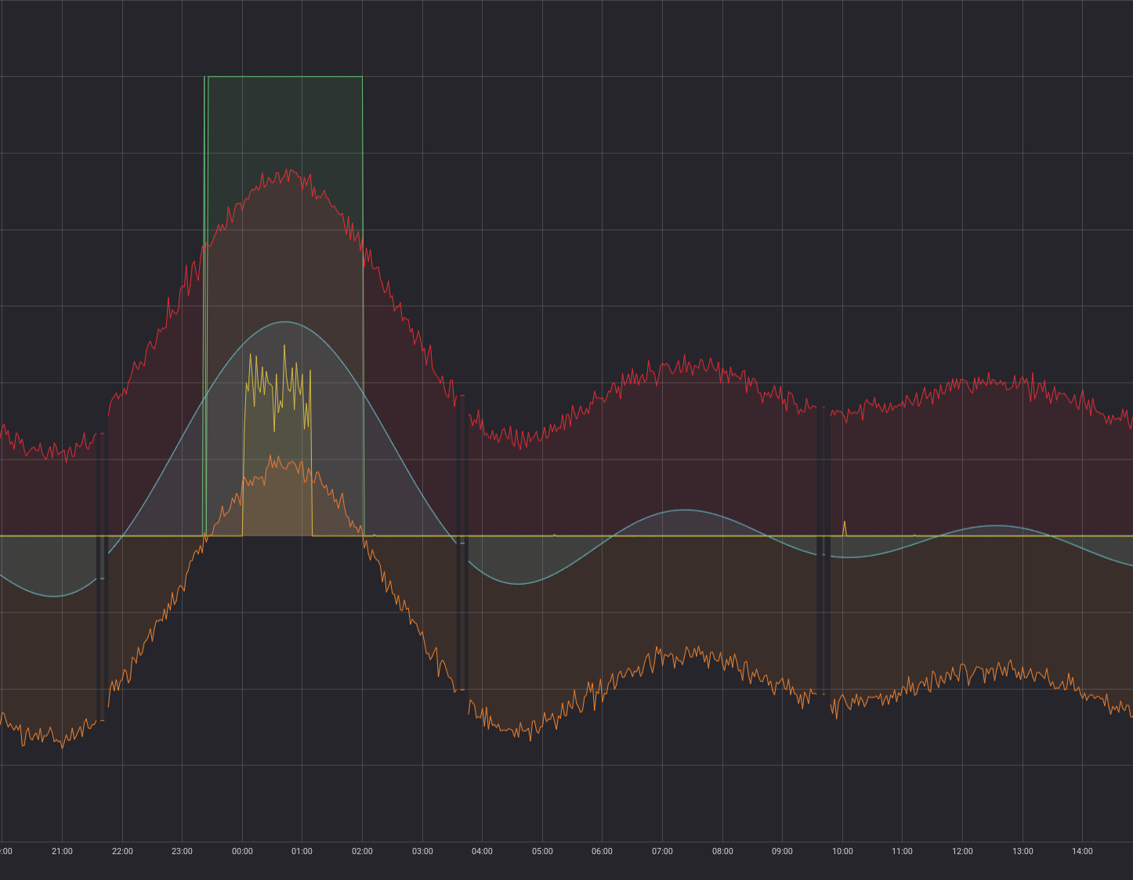
AI Ops
Grafana Dashboard Visualization
Anomaly
Predicted value
yhat_upper
Actual metric value
yhat_lower

Slide 15
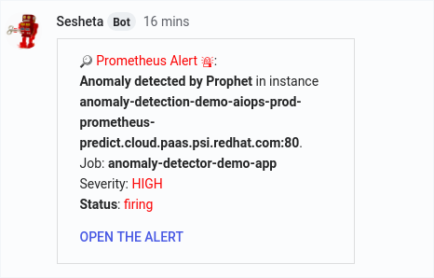
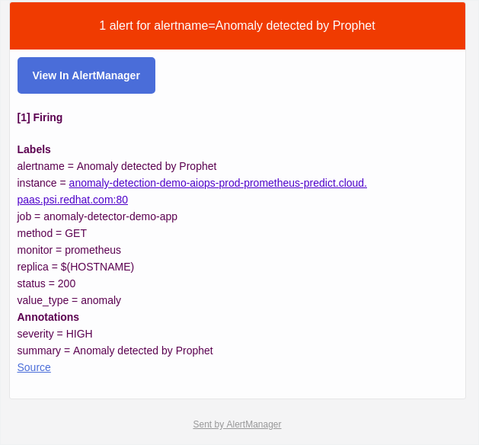
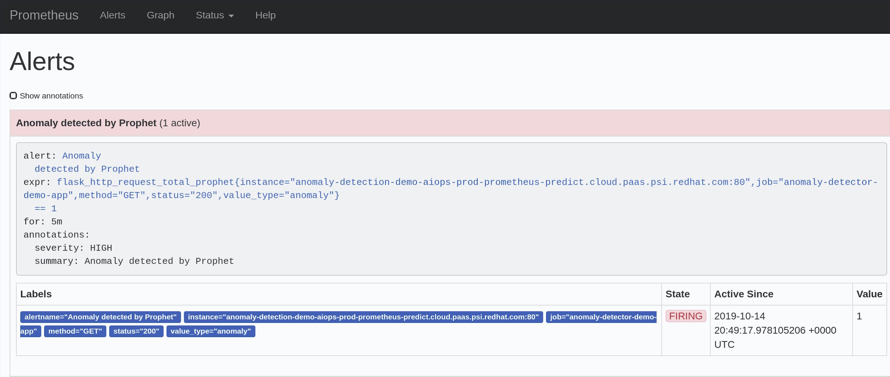
AI Ops
Alerting on Anomalies
Notes:
The alerts are configured to send automated messages through a chatbot via Google chats and email, notifying the respective teams. The google chat alerting architecture is maintained in two parts:
The predicted metrics are scraped by Prometheus
We configure the prometheus alertmanager to send a webhook trigger to the team Thoth’s bot, Sesheta which is configured to trigger alert notifications in google chat
The alerts are configured through alerting rules (specified in a yaml file) which allow you to define alert conditions based on Prometheus expression language expressions and to send notifications about firing alerts to an external service. Whenever the alert expression results in one or more vector elements at a given point in time, the alert counts as active for these elements' label sets.

Slide 16
References
AI Ops
Project Repository: https://github.com/AICoE/prometheus-anomaly-detector
Prometheus API Client: https://github.com/AICoE/prometheus-api-client-python
Mojo blog post: https://mojo.redhat.com/groups/red-hat-artificial-intelligence-center-of-excellence-ai-coe/blog/2019/09/10/prometheus-anomaly-detection-for-thoth-dgraph-metrics
Team Mail list: aicoe-aiops@redhat.com
GChat: AICoE - AIOps

Slide 17
Thank you
Red Hat is the world’s leading provider of enterprise open source software solutions. Award-winning support, training, and consulting services make Red Hat a trusted adviser to the Fortune 500.

